Slide 1


Integrated Water Management Solution

Slide 2


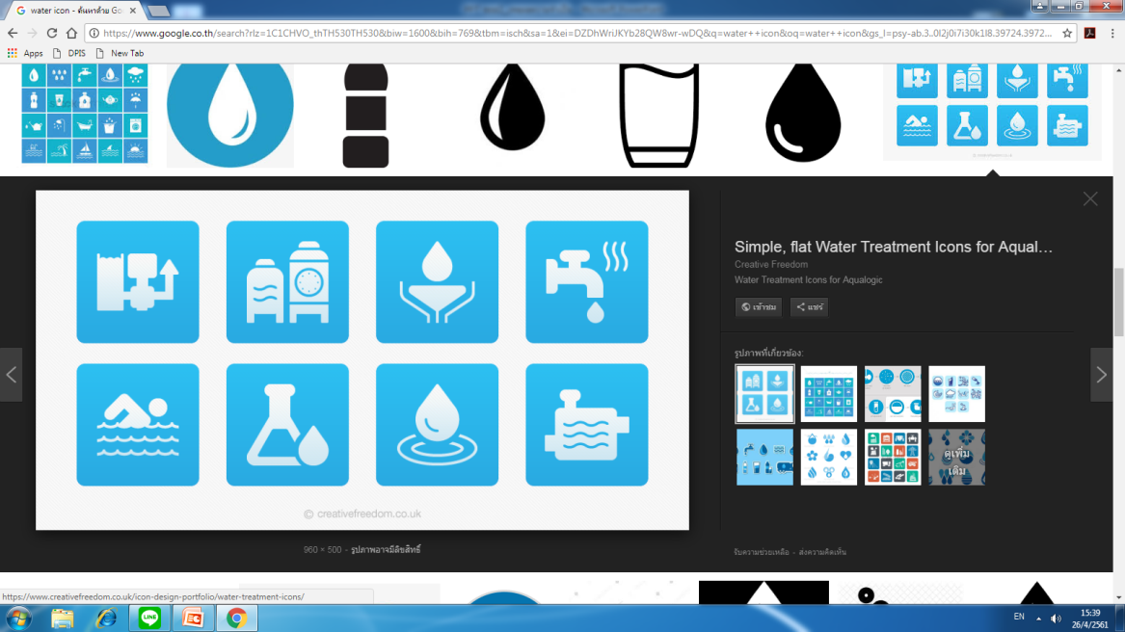



Understanding the Challenges of Water Management in Thailand
:Mechanisms of Water Resources Management
Linkages
Policy
Management
• The 20-Year National Strategy
Water Resources Management
• The National Water Resources Committee
• A 12-year water resources management strategy
• Office of the National Water Resources
Linkages
Linkages
Act
Water Resources Act + Ministerial Regulations
2
Notes:
Let start with the first slide. It shows the current Mechanisms of water resources management in Thailand which include
- Draft of Water Resources Act. It will give power to our organization in order to manage water. Act in this case means the law of water resource. And this will be plubish soon. May be in this year.
- The second pole is Water Resources Management Strategic Plan. It can be considered as the country goal to achieve. I will explain in the next slide
- and the last pole is the regulator pole which is Office of the National Water Resources and the National Water Resources Committee. They will be the lead and adviser of all water departments and agencies in order to solve and manage collaborative water issue.

Slide 3




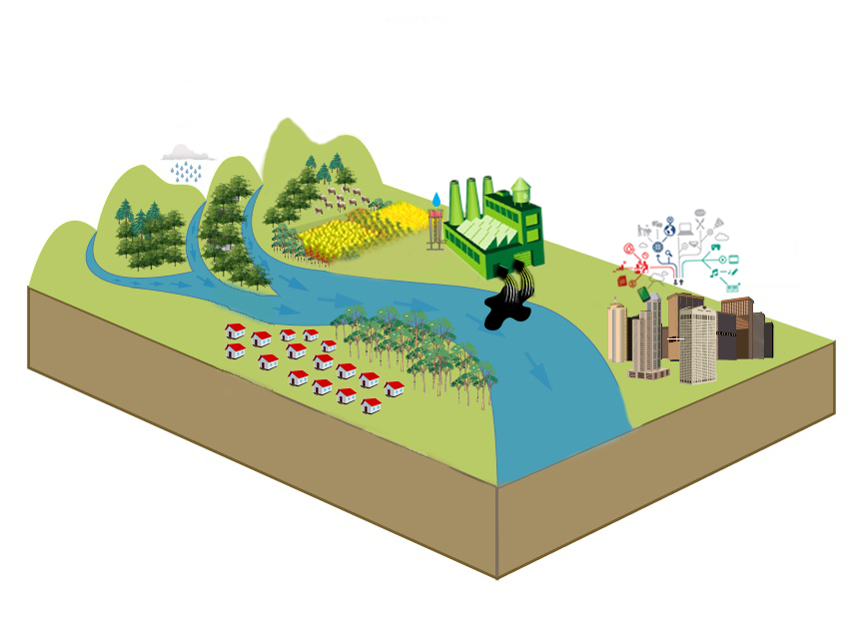




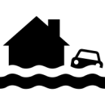
Policy : Water Resources Management Strategy 2015-2026
Creation for Water Security for Production (Agri. + Ind.)
9,500 million m³ (2,358 million m³)
Area 1.36 million Ha. (382,400 Ha.)
Water Quality Management
248 systems
(53 systems)
Upstream Forest Conservation and Soil Erosion Prevention
Area 763,200 Ha. (58,956 Ha.)
Management
Organizations
Legal of water resource
Decision Support Data System
Public relations and participation
Water Management for Consumption
7490 villages (7,234 vilages)
Flood Management
Protection Flood 168 cities (63 cities)
Dredging 870 km. (292 km.)
3
Notes:
Water Resources Management Strategic Plan is divided into 6 main point that are
This is the curent 10 years plan.
But We in recently we are publish Water Resources Management Strategy for 20 years to support thailand national strategy 20 years.
- Water Management for Consumption
- Creation for Water Security for Production
- Flood Management
- Water Quality Management
- Upstream Forest Conservation and Soil Erosion Prevention
- Administrative Management

Slide 4

Management : Water Resources Management Org.
• The National Water Resources Committee
Policy advisor
Regulator
Facilitator
GIS operation
,Remote sensing support
• Operational Agency
4
Notes:
This figure that shown u point to just 1 problem but it’s big and serious problem.
We have many many Org and Agency do and take action in Water resource Management
The top Commander is The National Water Resources Committee. (Prayut Chan-o-cha ,The Thailand/Prime minister is Chairman)
In the middle layer ONWR :office of the national water resource . The organization that established around 8 month.
And the position for org is dong act like modulator → for the command from The national Water Resource Committee. Policy advisor Regulator Facilitator
And in next layer We have around 34 agency do about Water Resources Management for the operation.
Group forecasts situation, such as the Department of Meteorology HAII GISTDA
Water Management Group such as the Royal Irrigation Department Department of Water Resources
Response / rehabilitation / support groups such as Ministry of Interior, Department of Administration, Department of Disaster Prevention and Mitigation, Royal thai Navy.
All of Agency using tools and operation data from GISTDA
But use just in case by ordering direction 2-way between gistda and each agency themself.
Need tools for central and same data in same platform .

Slide 5
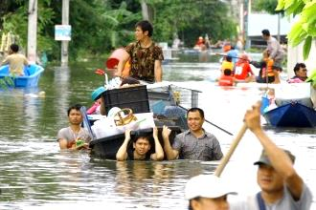
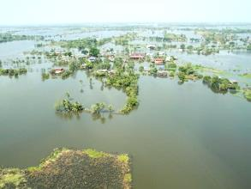




Key Issues:
Past experience : Extreme Flood and Drought
“Average rainfall is 46% lower than normal”
“Impacted of 13.43 Million people ”
Meteorological
drought
“Impacted of 4.04 Million households ”
“Water levels at 45% of whole reservoirs capacity”
“Damage cost THB 1,440 billion”
Hydrological
drought
“Rain-fed rice plantations is suffering in the major basin i.e. Chao Phraya river basin”
“GDP revised down from 2.6 % to 1.0 %”
Agricultural
drought
Source: Bank of Thailand /World Bank
5
Notes:
Thailand has occurred extreme flood in 2011 and extreme drought in 2014-2015.
The impacts of flooding include loss of human life, damage of properties and impact of agriculture, but those cannot avoid these situation. As the result, damage cost in 2011 was THB 1,400 billion (USD 45.6 billion) that is the highest record history.
In case of drought, we have more than 30 water-related agencies, and each agency use its own data to predict and play with drought management.
The Ministry of Agriculture and Cooperatives on 24 January 2017 sought Cabinet approval for 8 measures on water allocation. The measures involve efficiency in water use, an increase in the volume of usable water, and the development and rehabilitation of drought-hit farmland. Community plans will be worked out to ease drought conditions. Public relations campaigns will be stepped up on the issue, and knowledge dissemination on drought risk reduction will be emphasized.
The Department of Royal Rainmaking and Agricultural Aviation worked on rainmaking operations to increase water levels in various reservoirs, thus helping ease drought conditions in many areas across the country

Slide 6
Key Issues
In 2011, the Great Flood suffered of around 800 lives and over $45 billion in damages
In 2013, Thailand has recently embarked on an ambitious water management program ($11.7 billion), consisting of 9 modules including new dam and reservoir construction, watercourse management (river embankments), and a flood forecasting system.
Accurate knowledge of spatial-topology are essential elements in determining flood forecasting, flood hazard mapping and water course planning : For example
comprehensive elevation mapping,
the reservoir and dam depths for water volume calculations,
river basin mapping,
silting and dredging activities,
and inland water retention and
soil moisture content
etc

Slide 7
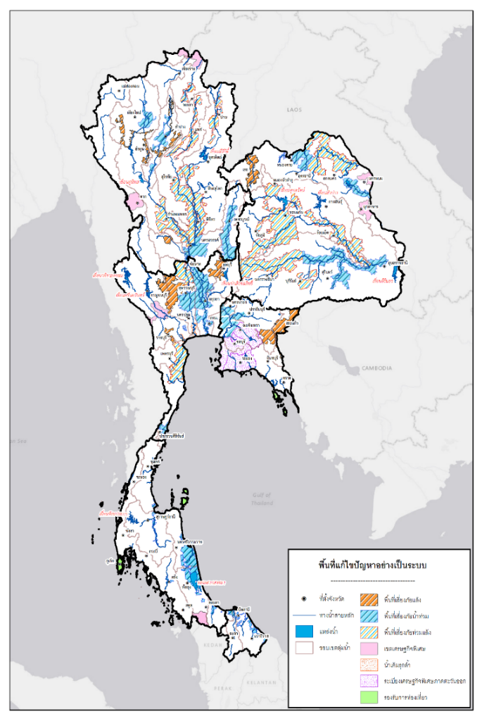
Management: Flood and Drought Resilience (Area Based)
Area-Based |  |  | Problem Area |  | Developed Area
 | Number of places | million hectare | Number of places | million hectare | Number of places | million hectare
Total Area | 66 | 4.75 | Flood 28 Drought 11 Flood and Drought 12 Saltwater intrusion 2 | 1.32 0.50 0.34 0.05 | SEZ 10 Tourist site 3 | 1.88 0.12
North | 16 | 0.98 | 14 | 0.67 | 2 | 0.31
Central | 13 | 1.13 | 12 | 0.99 | 1 | 0.15
Northeast | 12 | 0.71 | 10 | 0.50 | 2 | 0.20
East | 11 | 1.56 | 6 | 0.41 | 5 | 1.15
South | 10 | 0.35 | 7 | 0.16 | 3 | 0.19
Southern Border | 4 | 0.03 | 4 | 0.03 | - | -
Note: Consideration of Area Based must enhance public involvement and opinion into account.
* Urgent development area such as special economic zones and tourism location.
7

Slide 8
Concept of Operations
The Integrated water management solution/application aims to
balance dynamic water budget by monitor
dynamic water demand and
dynamic water supply
Tracking the spatiotemporal variations of water distribution
Near-Real time Analytic
Rain-fall → Run-off , flash flood ,Inundation
Run-off → flood
Inflow (Dam ,Reservoir)
Scope of location
More Emphasizing on Area-based
Basin , Sub-Basin
Province
Urban Area

Slide 9
Q&A Discussion

